Slide 1
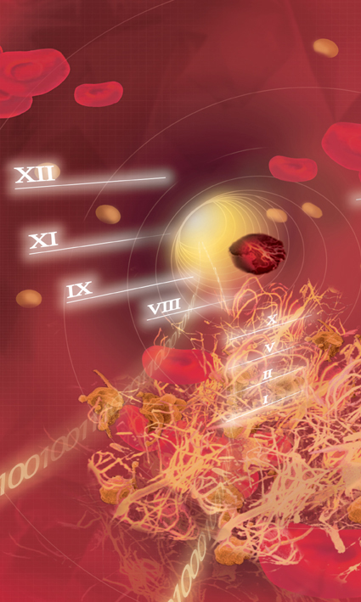



Introduction
to Hemostasis
connectivity
CA Systems

Slide 2
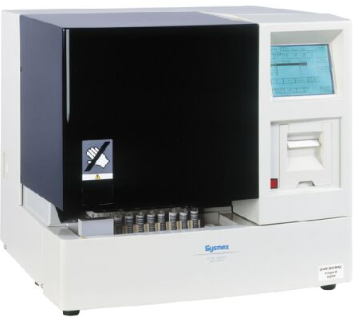

CA-500 CA-1500

Slide 3
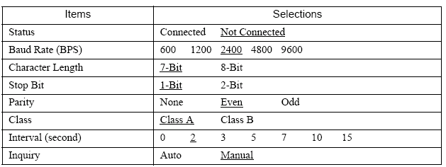

CA 500
Settings
Setting program “Settings” - “I/O Setting” - “Host Computer”

Slide 4
CA 500
Settings
Class
Class A
One-way transmission to the host computer without requiring ACK nor NAK from host computer.
Sample ID numbers is registered manually or read by barcode.
No order inquiry and analysis order information.
Only analysis data results are transmitted to host computer.
Class B
The CA transmits data and then waits for ACK or NAK to complete the data transmission.
Sample ID numbers is registered manually or read by barcode.
Bi-directional transmission Order inquiry (query host) or Analysis Order information (order information by rack number)

Slide 5
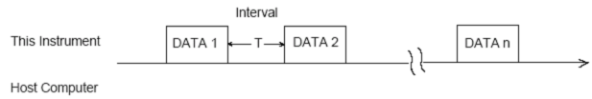
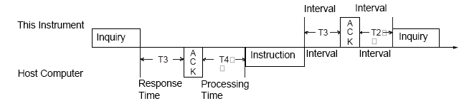
Interval
Transmission by block
Inquiry
The Interval time for the instrument can be set from 0 to 15 secs.
The Respond time and Processing time from host computer must be higher than >0,2sec [common used 1-2 sec]

Slide 6
CA 500
Settings
Inquiry
Manual
To receive order information for sample ID registered manually, by barcode or inquiry by rack, press [HC] from the worklist.
Auto
Automatic Inquire and register analysis parameters based on sample ID numbers registered manually or read by the barcode reader.

Slide 7
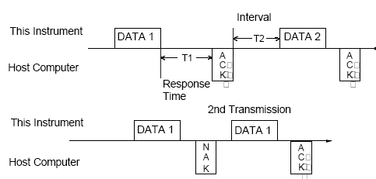
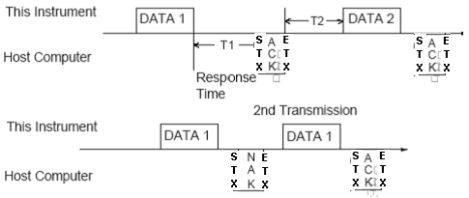
CA 500
Settings
ACK Test
ACK/NAK
STX-ACK-ETX, STX-NAK-ETX

Slide 8
CA 500
Parameter Code
SW00-09
Enter the service mode: Press [C], [9], [-], [0] in Work List screen on Main Menu.
Press [Special Menu] and [Standard Curve].
Select Test and [Code Set], Check or set the Host number.
SW00-15 thereafter
Enter the service mode: Press [C], [9], [-], [0] in Work List screen on Main Menu.
Press [Settings] and [Analysis Settings], [Test Protocol], choose the test.
Near the test (e.g PT, APTT;...) you find the Host ID.

Slide 9
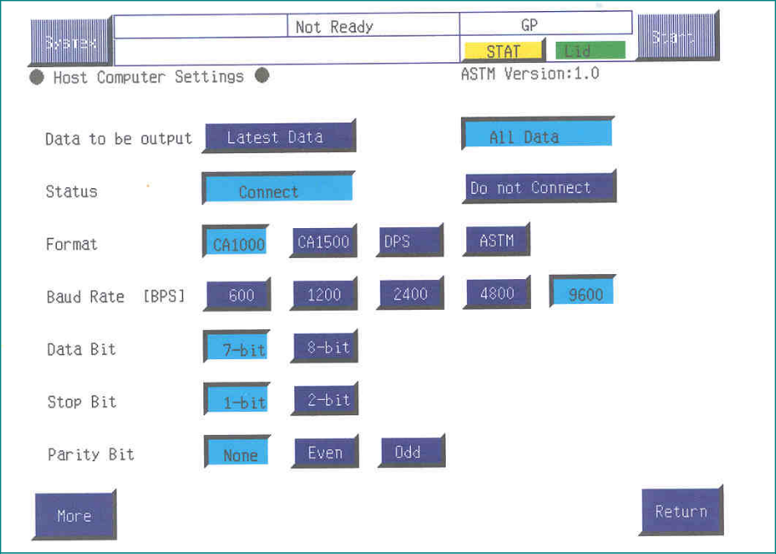
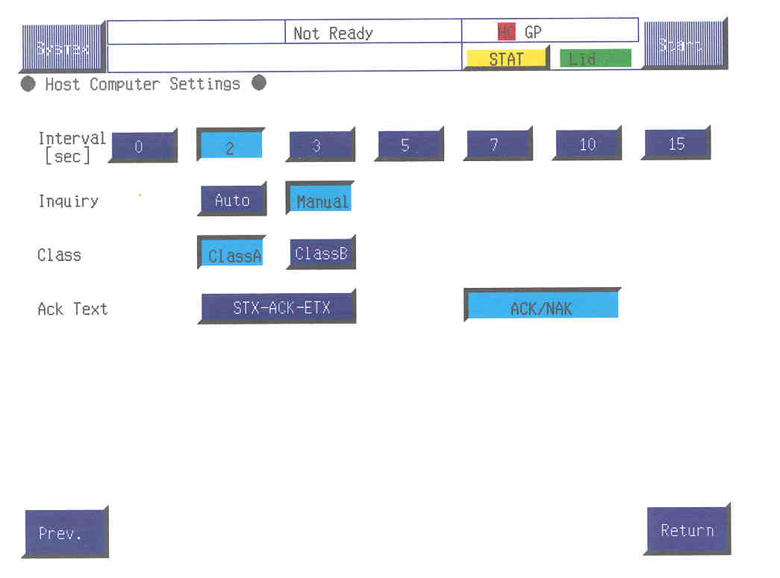
CA 1500
Settings
I/O Settings sub menu, press the [HC] key.

Slide 10
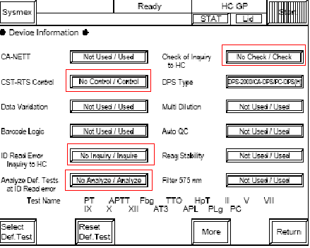
CA 1500
Settings
Service, Service Settings, Device Settings
CTS/RTS Control.
Selecting [No] ignores the RTS and CTS signals.
Selecting [Yes] refers to the signals.
ID Read Error-Inquiry to HC. Selecting inquiry the host will send an ID for the barcode not read correctly. (e.g Err0000000001). The LIS simulator send default tests (e.g PT,aPTT)
Analyze Def. Tests at ID Read ErrorSpecifies whether to analyze or not to analyze the ID Read Error samples according some programmed test.
Check of Inquiry to HC Check the inquiry if matched with the contents of the inquiry,

Slide 11
CA 1500
Parameter Code
Analysis Settings sub menu, press the [Test Protocol]
Select Test
Parameter Code This code is used for communication with the host computer.
Set the code, maximum of 2-digit (e.g 4 is is sent as 040)

Slide 12
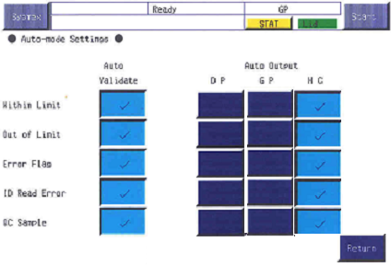
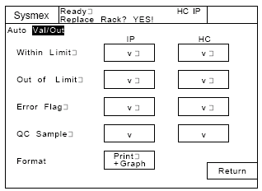
CA
Automatic Mode Settings
Automatic transmission (real-time basis)
Settings sub menu, press the [Auto Val/Out]
CA-1500
CA-500

Slide 13
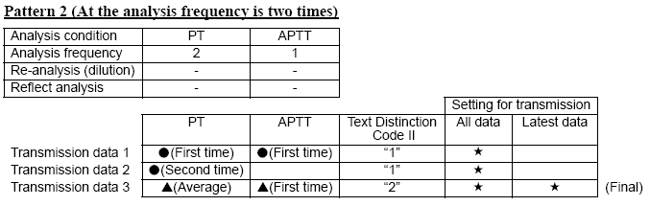
CA-1500
Settings
Data to be Output”
Latest Data
the analysis result for all parameters is transmitted collectively for one sample
All Data
each single result is transmitted.

Slide 14
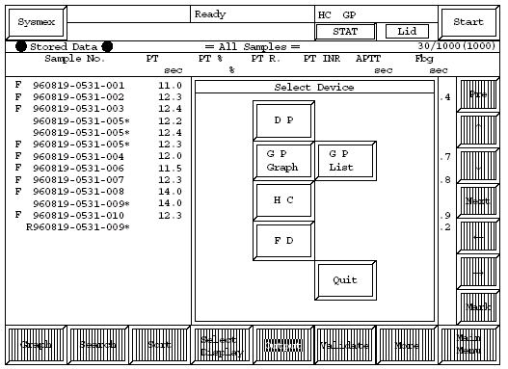
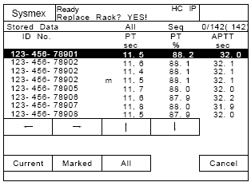
CA
Output data
Manual output of Analysis Data
[Stored Data] key on the Main Menu screen Analysis results that are in memory as stored data can be output to host computer.
CA-1500
CA-500

Slide 15
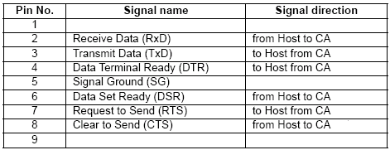
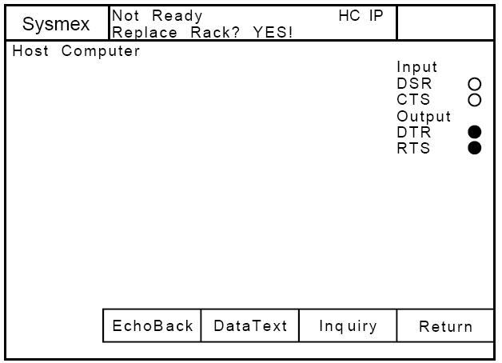
Cable and Connectors
CA500 series
DB-9
CA-500 System test
RTS(asserted high by instrument CAN TRANSMIT DATA)
DTR (asserted high by instrument ONLINE)
CA-500 requests its DSR, CTS to high level

Slide 16
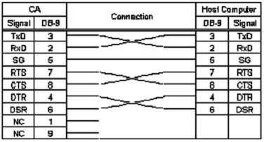
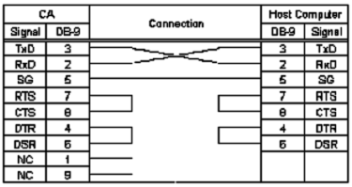
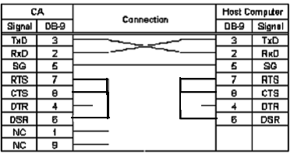
Cable and Connectors
CA series
Format CA500, CA1000, CA1500, CA7000
Format CA500, CA1000, CA1500, CA7000, ASTM
All Formats with/without RTS control CA500, CA1000, CA1500, CA7000, ASTM

Slide 17
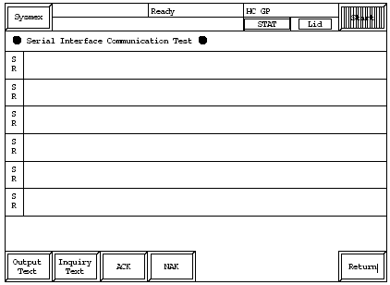
Cable and Connectors
CA-1500 series
CA-1500 System test- Special Menu-System Test-HC
A first diagnostic on communication can also tested in user prg. The CA send record or control characters according the format (CA1000,etc)selected in I/O settings.

Slide 18
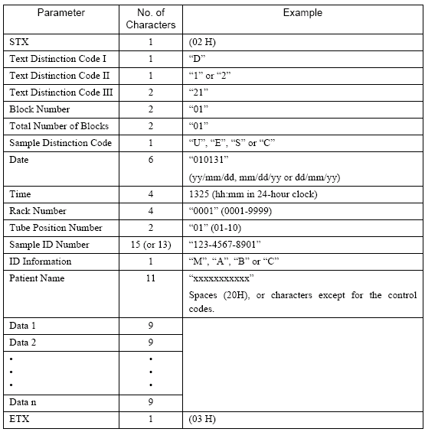
Format
CA500, CA1000
Data Format
(CA 1000)

Slide 19
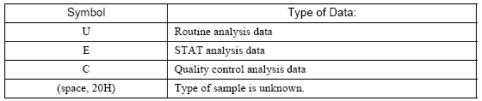
Format
CA500, CA1000
Text Distinction Code I
D Patient Sample Data
R for the Inquiry Data
S for the Order Information Data
Text Distinction Code II
D Patient Data results
“1”: Normal single analysis data
“2”: Mean data of replication analyses.
R for the Inquiry Data S for the Order Information
“1”: The key word is “Rack No. and Tube Pos.”
“2”: The key word is “Sample ID No.”
Sample Distinction Code
Rack No.
0001” through “0099 [CA500-CA1000]
000001” through “000099 [CA1500]

Slide 20
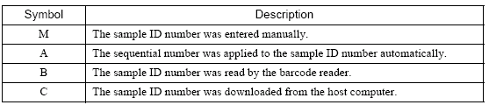
Format
CA500, CA1000
Tube Position No.
“01” through “10”, “00” for the STAT sample.
Sample ID
15 digits including hyphens “-” CA500,CA1500
13 digits including hyphens “-” Format CA1000
ID information
Patient Name
11 characters format CA500, CA1000
15 characters format CA1500
Data
Parameter Code
Data
Flag

Slide 21
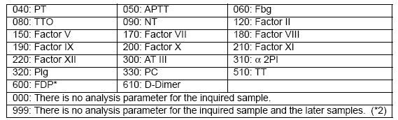

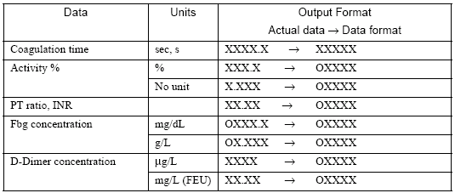
Format
CA500, CA1000
Parameter Code
When there is no analysis parameter for the inquired sample ID number, set "000" for the parameter code.
When there is no analysis parameter for the inquired sample and the later samples, set "999" for the parameter code.
Data
Note the sample results transmitted are:
Right aligned
Result as whole number ( no differentiation with decimal points)

Slide 22
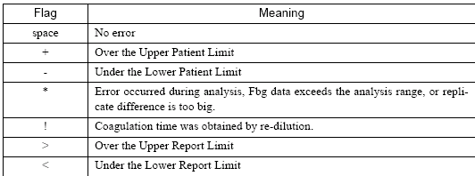
Format
CA1000 CA1500
Flags

Slide 23
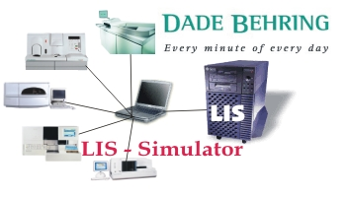









LIS Simulator
Ver.1.0 ßeta
Open a LOG file to save captured communication data.
Close and save LOG.
Open communication settings to configure communication
parameters like Baudrate, Parity etc.
View protocol window communication data.
View load list
Switch to “capture mode”.
Switch to “active LIS mode”.
Select or change type of analyzer.
View help documentation.

Slide 24


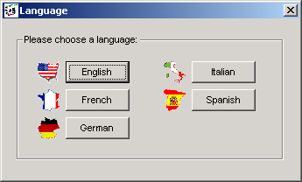



LIS Simulator
Ver.1.0 ßeta
General program information.
Shows current selected
language. Click to
change.
Quit program.
Double-click on traffic light opens/closes
communication port.

Slide 25
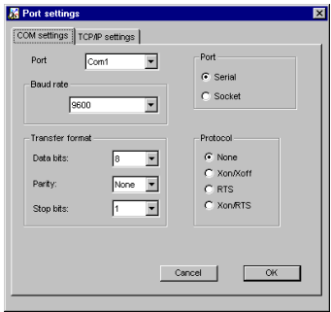
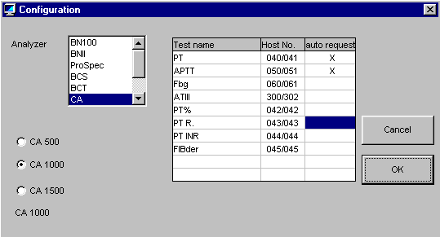
CA LIS Simulator
Ver.1.0 ßeta

Slide 26
Inquiry to Host
06.08.04 16:58:5270 <- <STX>R2210101U0604041656000101 103B 040 050 060 300 500 <ETX>
06.08.04 16:59:510 -> <ACK>
06.08.04 16:59:51390 -> <STX>S2210101U0604041656000101 103B 040 050 <ETX>
06.08.04 16:59:51390 <- <ACK>
06.08.04 16:59:51390 <- <STX>R2210101U0604041656000105 101B 040 050 060 300 500 <ETX>
06.08.04 16:59:56330 -> <ACK>
06.08.04 16:59:57100 -> <STX>S2210101U0604041656000105 101B 040 050 <ETX>
Transfer Results to Host
06.08.04 17:00:02370 <- <STX>D1210101U0604041711000101 103B 041 523 042 127 044 473 045 174 051 926*<ETX>
06.08.04 17:15:03430 -> <ACK>
06.08.04 17:15:03430 <- <STX>D1210101U0604041713000105 101B 041 274 042 270 044 244 045 77 051******<ETX>
06.08.04 17:17:03440 -> <ACK>
06.08.04 17:17:03440 <- <STX>D1210101U0604041716000108 102B 041 501 042 134 044 452 045 143 051 906*<ETX>
06.08.04 17:20:33580 -> <ACK>

Slide 27
Format CA500 CA1000
Format CA500, CA1000 ()

Slide 28
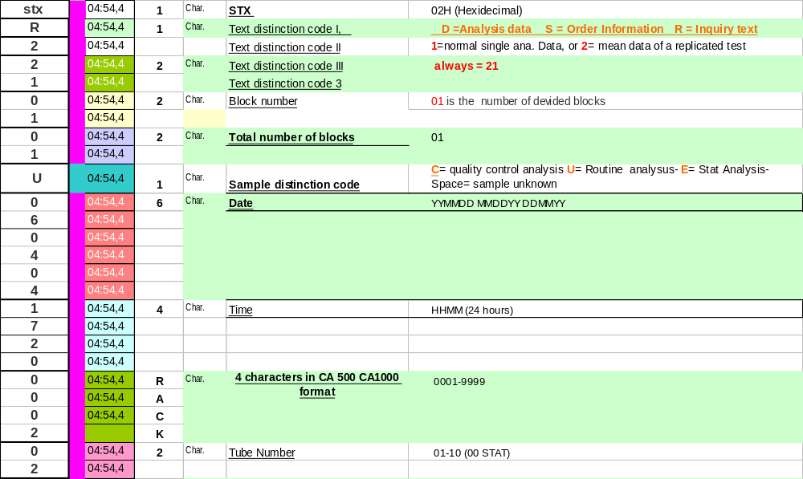
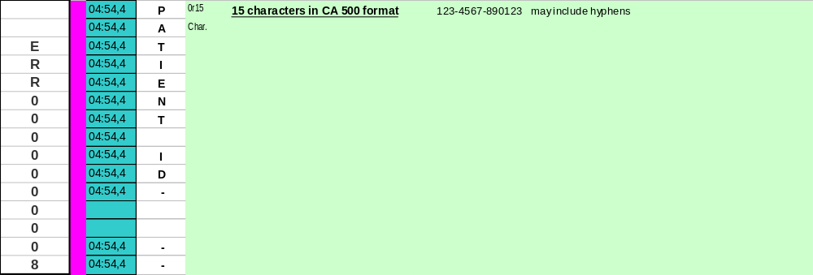
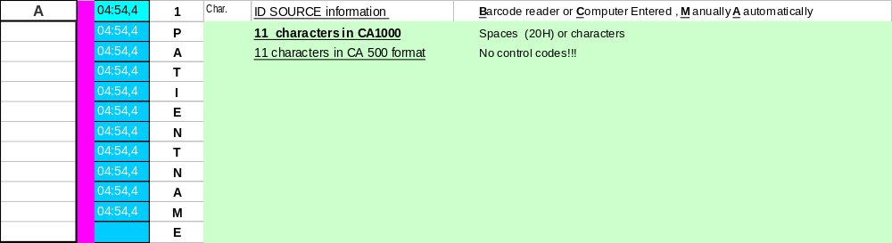
Inquiry [Format CA500]

Slide 29
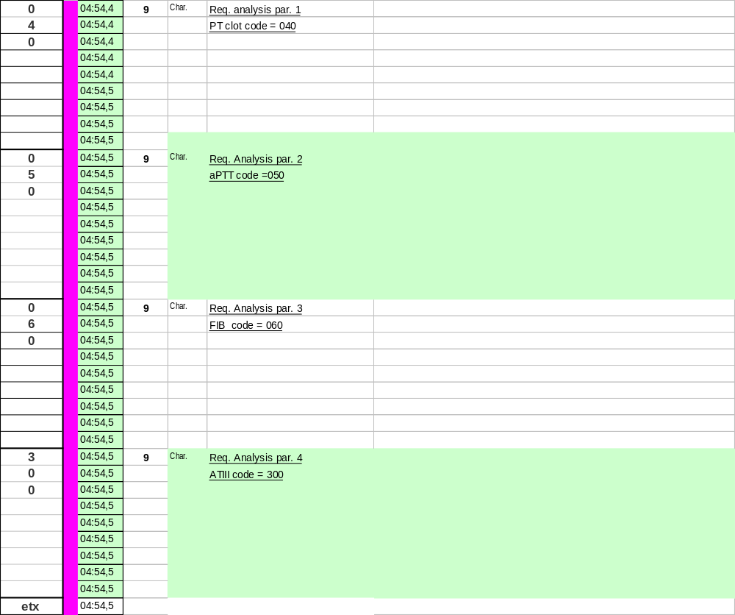
Inquiry [Format CA500]

Slide 30
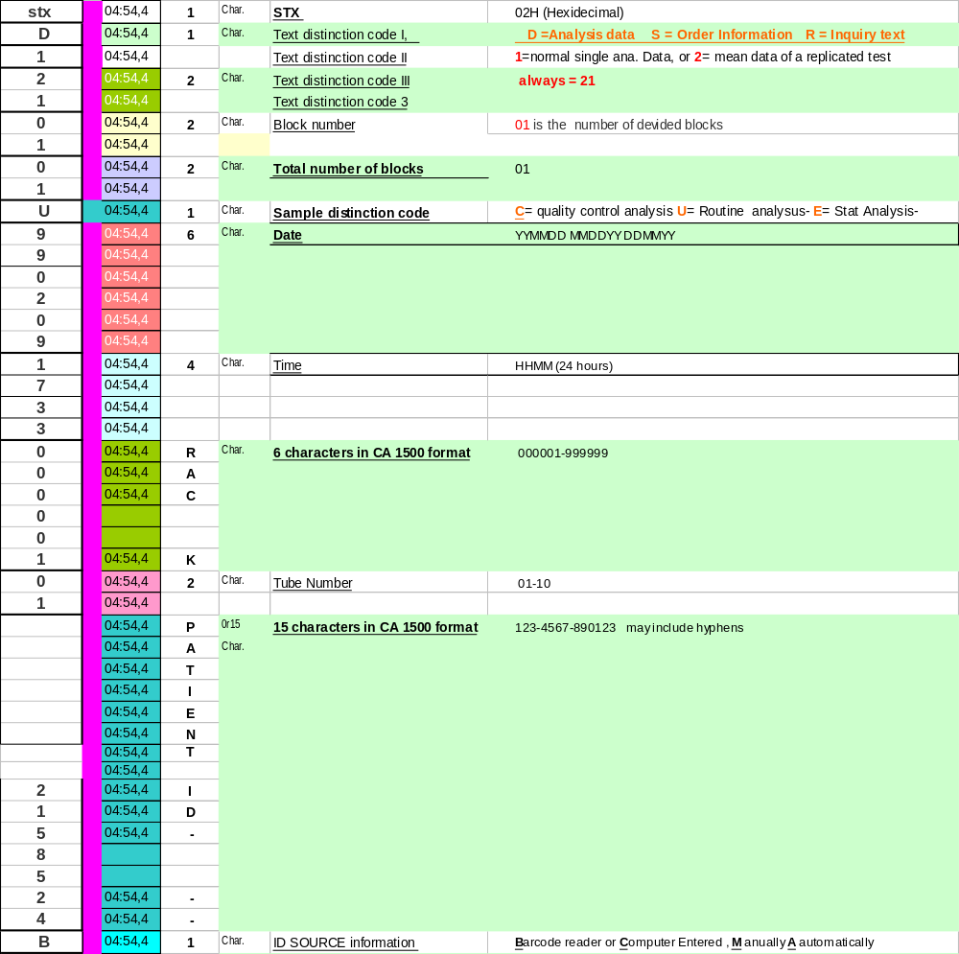
Patient Sample Data [Format CA1500] DA verificare Sample name 13

Slide 31
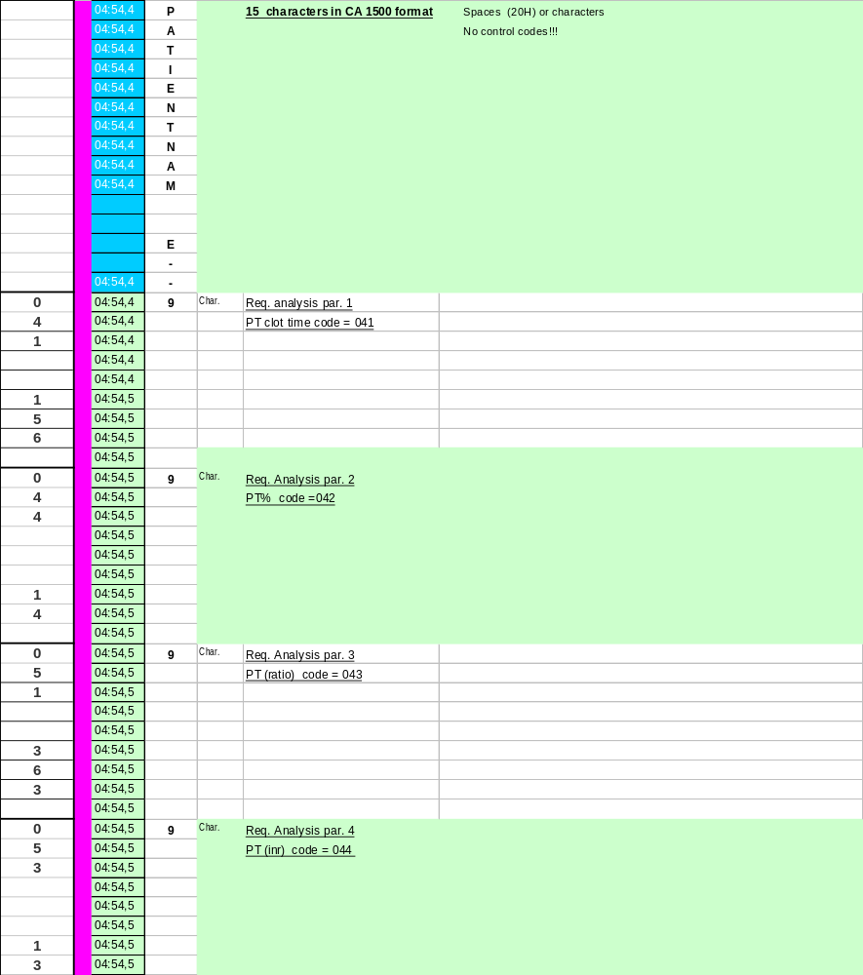
Patient Sample Data [Format CA1500]

Slide 32
CA
ASTM
ASTM has divided communication with LIS in two levels, LOW and HIGH.
• The LOW level part (ASTM document E1381-91) defines how data should be interchanged (compare this with traffic rules). It tells e.g. that data should be devided in frames with starting en ending characters and checksum calculation for error reduction.
• The HIGH level part (ASTM document E1394-91) defines the data format (compare this with the vehicle definition). This describes e.g. fields that are in a message, and what kind of data may be put in these fields.

Slide 33
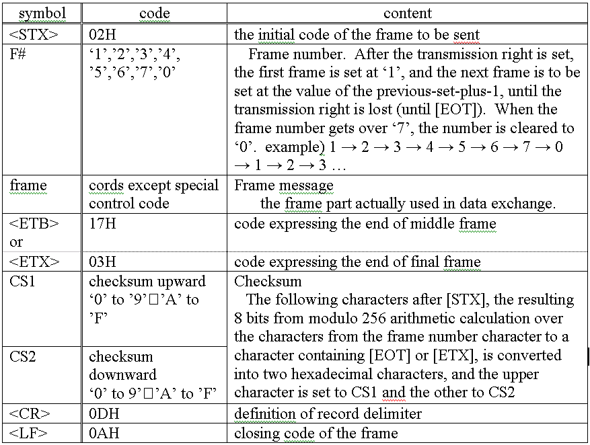
ASTM
Transfer mode
Typical transfer structure
[STX] [F#] [Frame] [ETX] [CHK1] [CHK2] [CR] [LF]
If the volume of text exceeds 240 characters
[STX] [F#] [Frame] [ETB] [CHK1] [CHK2] [CR] [LF]

Slide 34
CA
ASTM example Low Level
28.06.04 16:07:52720 <- <ENQ>
28.06.04 16:08:4740 -> <ACK>
28.06.04 16:08:4740 <- <STX>1I 12345<ETX>9C<CR><LF>
28.06.04 16:08:47920 -> <ACK>
28.06.04 16:08:47920 <- <EOT>

Slide 35
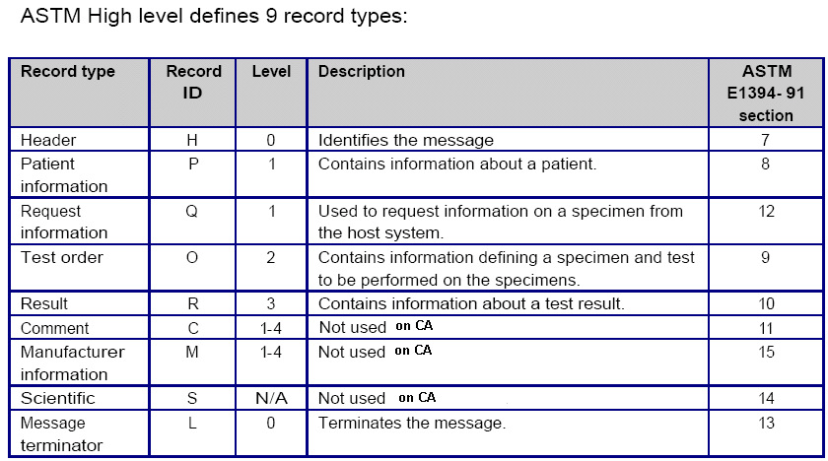
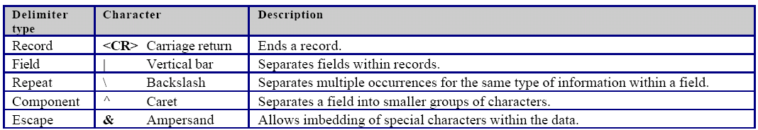
CA
ASTM example High Level
Records
Each record is divided in fields and some fields can be divided in sub-fields.

Slide 36
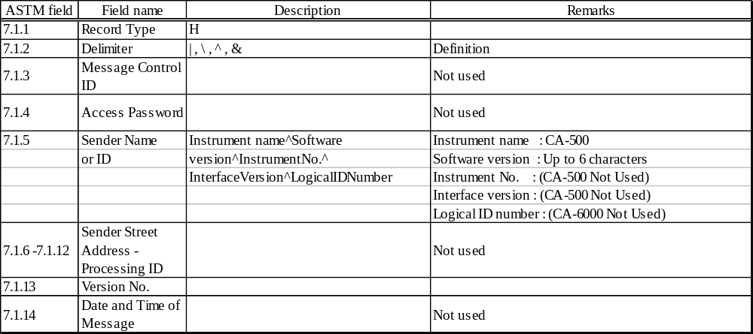
ASTM CA-500 Example
Requests Information
Example: Request instruction procedure
CA-><ENQ>
HC-><ACK>
CA-><STX>1H|\^&|||CA-500^ 00-09||||||||1<CR><ETX>24<CR><LF>
HC-><ACK>
CA-><STX>2Q|1|000001^01^ 12345^M||^^^040^PT \^^^050^APTT \^^^060^Fbg \^^^300^TT |O|19990315090700<CR><ETX>72<CR><LF>
HC-><ACK>
CA-><STX>3L|1|N<CR><ETX>06<CR><LF>
HC-><ACK>
CA-><EOT>
Header record
H | \ ^ & | | | CA-500^SoftwareVersion | | | | | | | | 1 <CR>

Slide 37
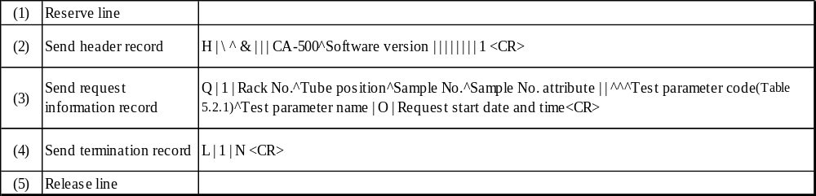
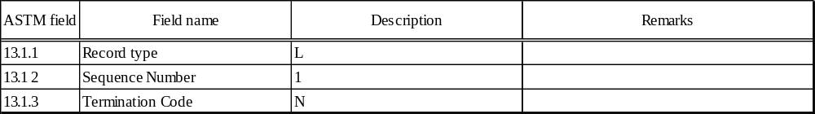
ASTM CA-500 Example
Requests Information
CA-><STX>2Q|1|000001^01^ 12345^M||^^^040^PT \^^^050^APTT \^^^060^Fbg \^^^300^TT |O|19990315090700<CR><ETX>72<CR><LF>
HC-><ACK>
CA-><STX>3L|1|N<CR><ETX>06<CR><LF>
HC-><ACK>
CA-><EOT>

Slide 38
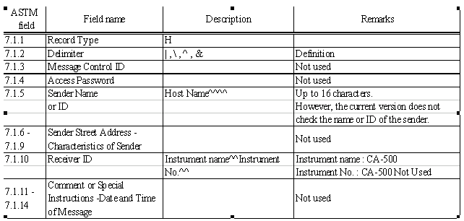
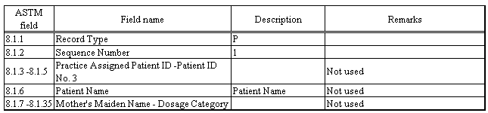
ASTM CA-500 Example
A host computer outputs
A host computer outputs indication immediately after inputted request
HC-><ENQ>
CA-><ACK>
HC-><STX>1H|\^&|||HostTest_V1.12b9^^^^|||||CA-500<CR><ETX>D3<CR><LF>
CA-><ACK>
HC-><STX>2P|1<CR><ETX>3F<CR><LF>
CA-><ACK>
HC-><STX>3O|1|000001^01^ 12345^C||^^^040^^100\^^^050^^100|R|19990312140000|||||N<CR><ETX>EF<CR><LF>
CA-><ACK>
HC-><STX>4L|1|N<CR><ETX>07<CR><LF>
CA-><ACK>
HC-><EOT>

Slide 39
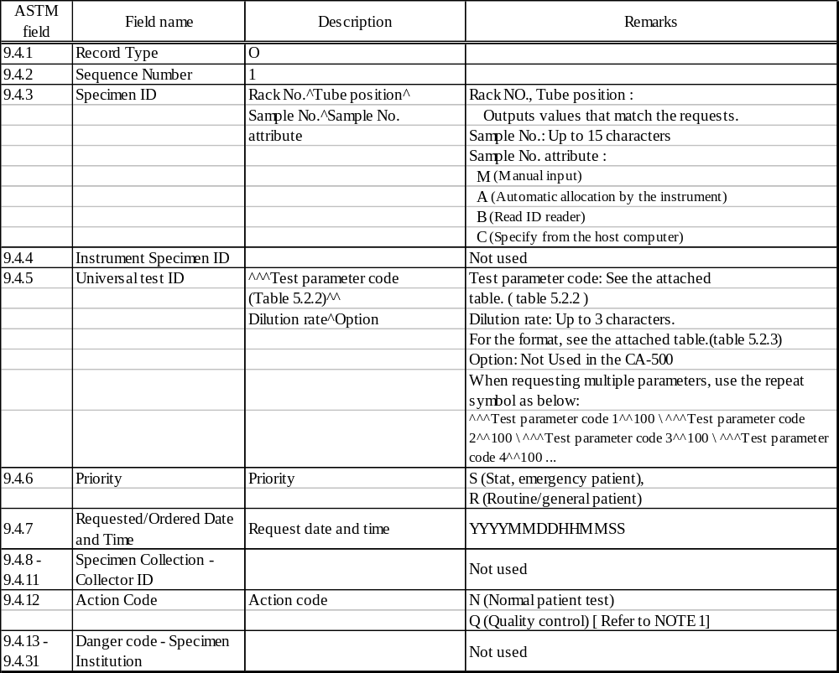
ASTM CA-500 Example
A host computer outputs
HC-><STX>3O|1|000001^01^ 12345^C||^^^040^^100\^^^050^^100|R|19990312140000|||||N<CR><ETX>EF<CR><LF>

Slide 40
Result in ASTM
Example Result
CA-><ENQ>
HC-><ACK>
CA-><STX>1H|\^&|||CA-500^ 00-09||||||||1<CR><ETX>24<CR><LF>
HC-><ACK>
CA-><STX>2P|1<CR><ETX>3F<CR><LF>
HC-><ACK>
CA-><STX>3O|1||000001^01^ 12345^M^||R||||||N<CR><ETX>3D<CR><LF>
HC-><ACK>
CA-><STX>4R|1|^^^041^PT ^100^1| 15.2|sec ||N||||||19990315092200<CR><ETX>07<CR><LF>
HC-><ACK>
CA-><STX>5R|2|^^^042^VII ^100^1|480.4|% ||N||||||19990315092200<CR><ETX>70<CR><LF>
HC-><ACK>
CA-><STX>6R|3|^^^051^APTT ^100^1| 50.3|sec ||A||||||19990315092200<CR><ETX>54<CR><LF>
HC-><ACK>
CA-><STX>7L|1|N<CR><ETX>0A<CR><LF>
HC-><ACK>
CA-><EOT>

Slide 41
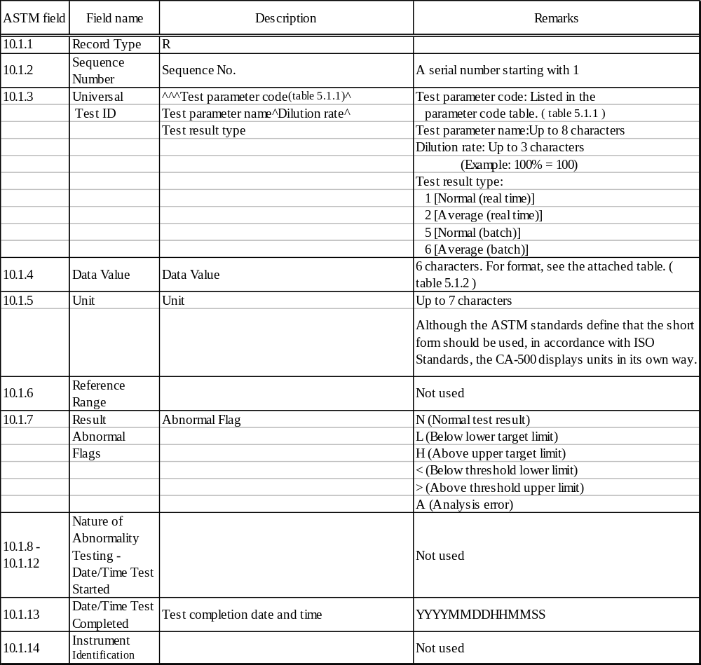
Result in ASTM
CA-><STX>4R|1|^^^041^PT ^100^1| 15.2|sec ||N||||||19990315092200<CR><ETX>07<CR><LF>

Slide 42
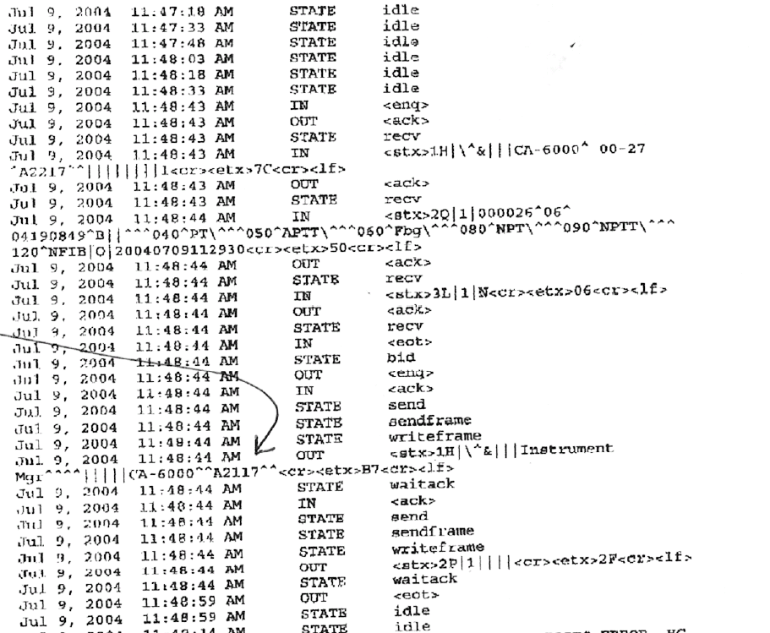
CA
ASTM example High Level

Slide 43
CA exercise
Joblist
Perform a joblist
Press Settings- I/O Settings- HC. Check configuration and set CA1000
Press Service Device Settings and set RTS CTS control “Not Used” [CA1500]
Start LIS SIM, check configuration and define the instruments and format
Set 2 samples with barcode or set manually
Perform a joblist and verify the record

Slide 44
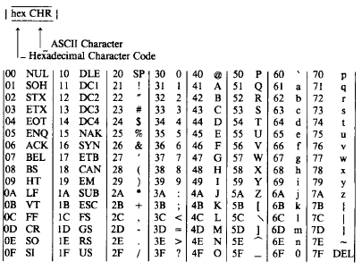

CA exercise
Hex-ASCII
In LIS simulator the communication log represents a lot of ASCII characters. Often the log represents only Hex chrs. Therefore you need to translate them.

Slide 45

CA exercise
Hex-ASCII- Solution

